Slide 1

Merry Go Round Project
PERFORMANCE EVALUATION OF COMPUTER SYSTEMS AND NETWORKS
Bruk Tekalgne, Leonardo Fontanelli

Slide 2
The Merry Go Round: introduction of the problem
MERRY GO
ROUND
has N seats
OBJECTIVES
Evaluate the earnings per unit of time
Children pay one coin for a ride, and occupy a seat
Children arrive to the MGR with some interarrival time and queue up
The owner may decides to start a ride even if the MGR is not full
Depending on the owner’s threshold and the children’s patience (Q).
ride takes T units of time, meanwhile anyone else is taken onboard
The statistic has to be evaluated in a exponential interarrival and burst (geometrical) interarrival scenarios
They may decide to drop out from the queue after some threshold Q

Slide 3
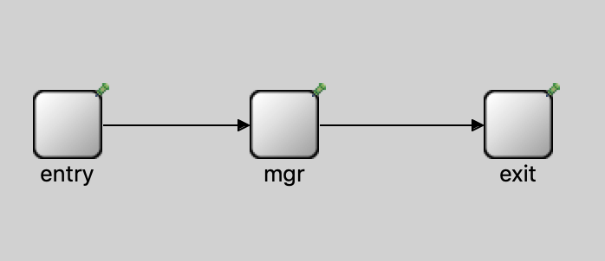
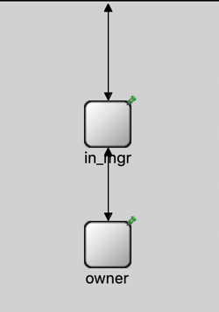
Modelling in Omnet++
MGR
Compound module
ENTRY
IN_MGR
OWNER
Responsible of generating and sending the children to the MGR both with exponential and burst interarrivals.
Queues up the children that are waiting for the MGR and those who are enjoying a ride, send notification to the Owner’s module for every event
The module responsible of taking the decision of the ride of the MGR, and collects the money.

Slide 4
Code analysis and factors definition
ENTRY MODULE
Children modelled as an extension of cMessage structure with a “patience” field for the threshold
OWNER MODULE
Periodically collects the earning statistic.
Money – lastmoney
With the notification from the IN_MGR, decides whether to start a ride with a cMessage notification back to IN_MGR
Exponential interarrival
exponential(mean,rng)
rng = 2
FACTORS
Burst arrival
geometric(p, rng)
rng = 3
Number of seats (N) (N=10)
Ride time (T) (T=5s)
Children’s Threshold (Q)
Owner’s Threshold (th)
Mean Interarrival
IN_MGR MODULE
Queues up children in a cQueue structure.
Notify the owner for every event and receives commands from him with cMessage
Periodically decrements and check for the children’s threshold. If less than 0 drops the child.

Slide 5
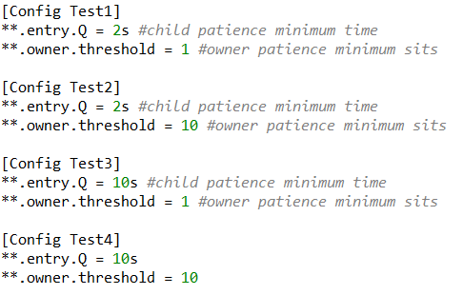
Validating the code and calibrating the simulator
VALIDATION
TEST DEFINITION
MEAN INTERARRIVAL TIME
In order to validate our code we put some «stress» values in the factors to check the behavior
The purpose is to mix «low» and «high» values of both Q and owner’s threshold to compare the contribution of the factors in the model
Significant effect on the result.
Our region of interest is when the conditions holds
Trial 1: QUEUE
Trial 2: DROP-OUT
Trial 3: EVERY CHILDREN SERVED
Mean interarrival * Sit Num ~ ride_time
Money Collection
money = generatedChild – childrenInTheQueue – childrenDropped – occupiedSits
Selecting a mean value different from 0,5, the result is regardless the variation of the factors

Slide 6
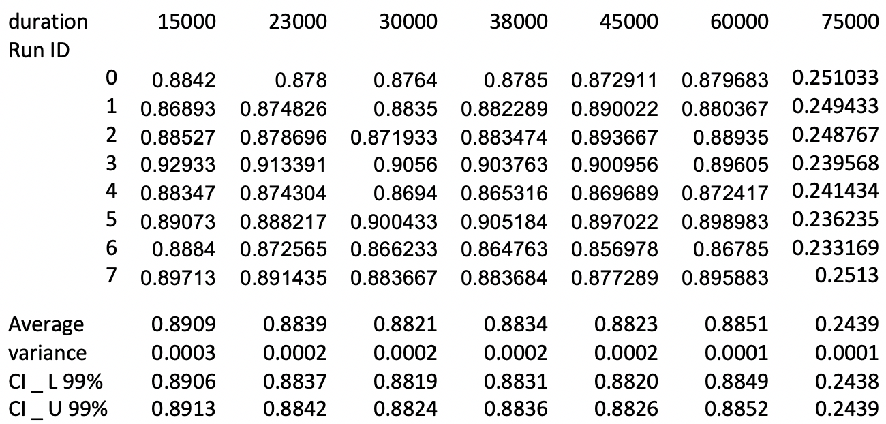
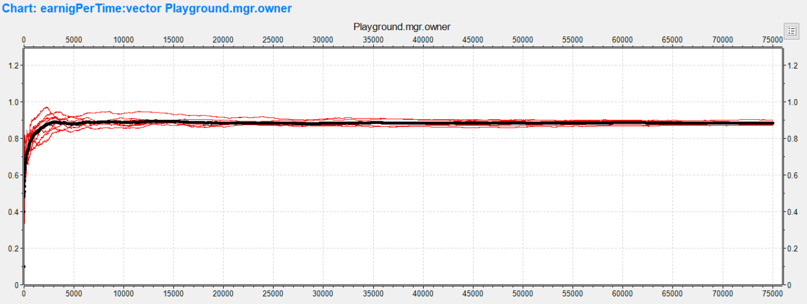
Calibrating the simulator (2)
DURATION SELECTION
WARMUP PERIOD
Computed sample mean and variance for every test
Test 1 is the one that shows the large variation in the result.
From the above table the best duration is 75000s because it has the least value for the variance and similar CI
The above is the plot for the Test 1 case.
Values tends to get close to the aggregate in 15.000s, we select for safety 20.000s as warmup period.
Adding 75.000s duration we select a total duration of 95.000s

Slide 7
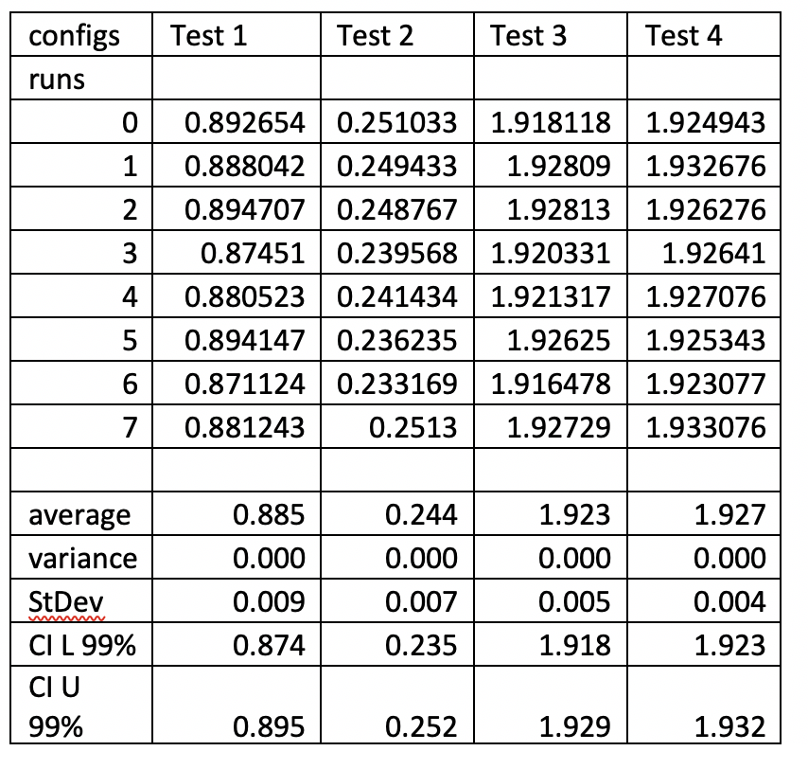
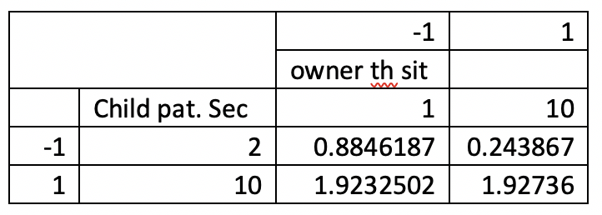
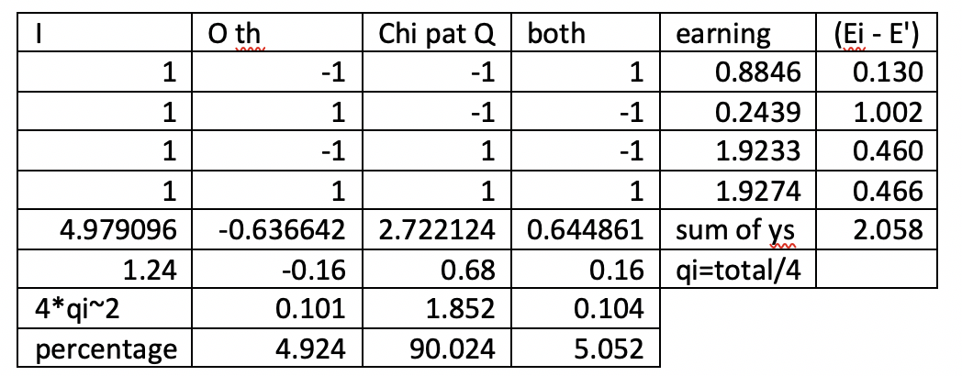
Exponential Interarrival Analysis (1)
Data collection for the earning per unit of time for every test with 8 different RunIDs
Impact analysis of changing the owner minimum sit and child min patience values and the interplay between the two
The 90% of the increase due to children patience and the owner minimum sit threshold is nearly equal to the combine effect of both factors witch is 5%. The –ve @-0.16 indicates decremental effect.

Slide 8
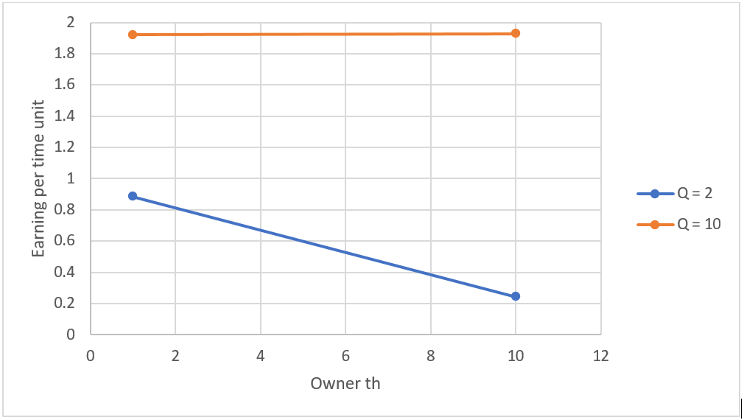
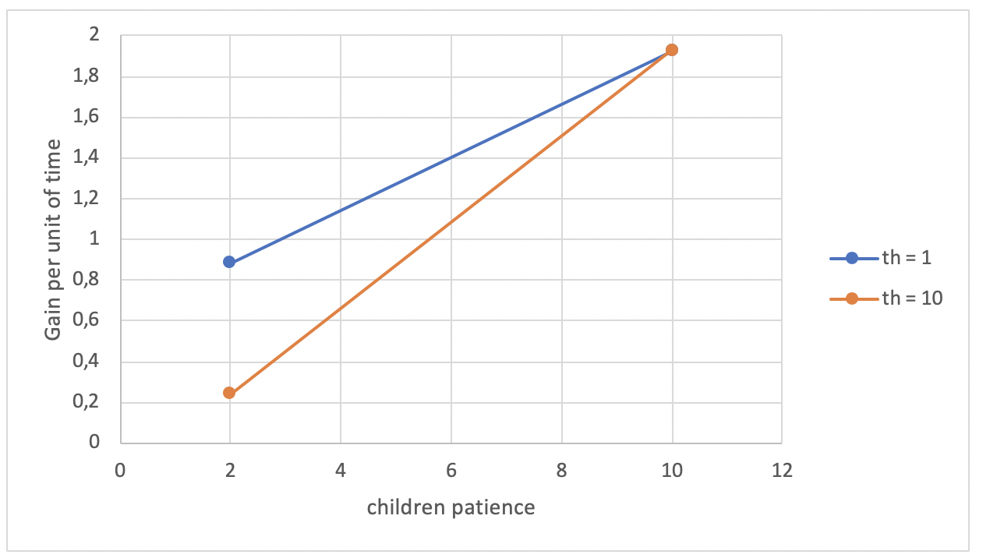
Exponential InterArrival Analysis (2)
Plots for fixed values of both children’s patience and owner’s threshold
High children patience
Impact of the owner with his threshold has insignificant effect
Earning almost equal
Minum patience of 10 seconds
Low children patience
The earning can be kept high by decreasing the min sit threshold
Earning diverges
patience goes down from 10s to 2s, low th decreases wiht small rate

Slide 9
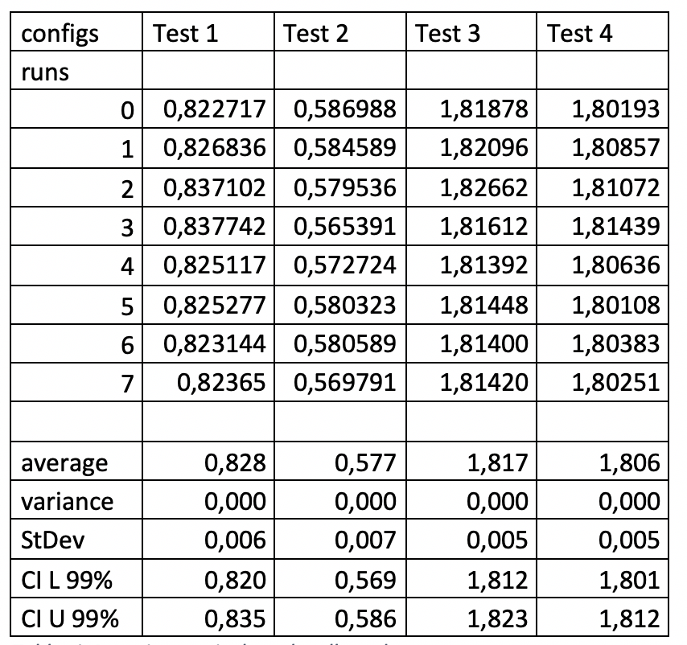
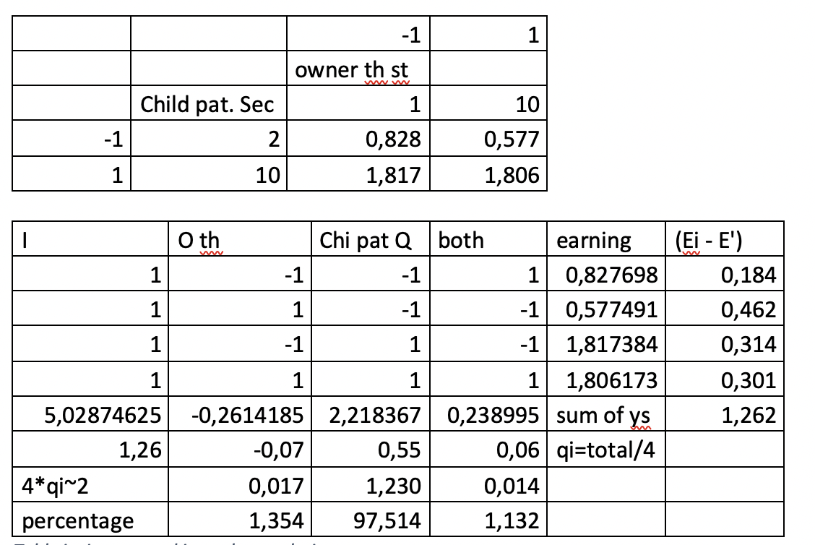
Burst InterArrival Analysis (1)
Given the same load as the exponential case. We collected the statistic for the same 4 tests as before
Impact analysis of changing the owner’s minimum sit and child’s min patience values and the interplay between the two
The 97% of the variation is due to children patience and the owner’s threshold has a 1,3% impact, similar to the combined factors. Also the –ve @-0.07 indicates opposite effect

Slide 10
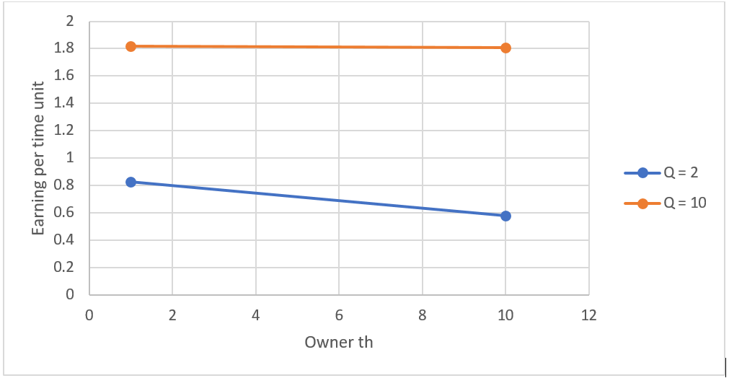
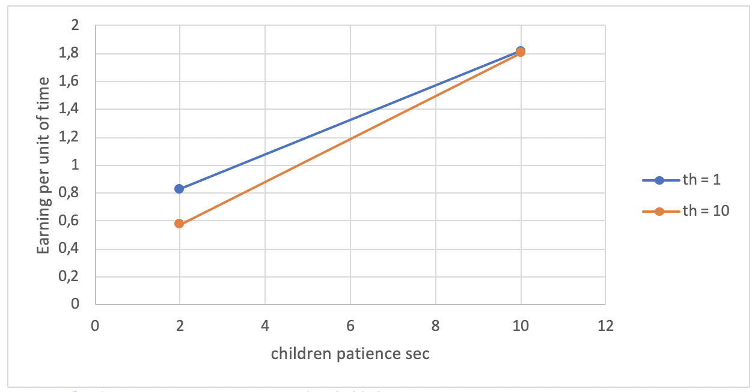
Burst InterArrival Analysis (2)
Plots for fixed values of both children’s patience and owner’s threshold
When Q=2. The earning decreases when th increases
Earning almost equal
Ow th fixed to 10 and 1 and Q = 10 at high patience
Owner has slight impact
Owner has no consequence
Earning diverges
When the children’s patience decreases to 2s
When Q=10

Slide 11
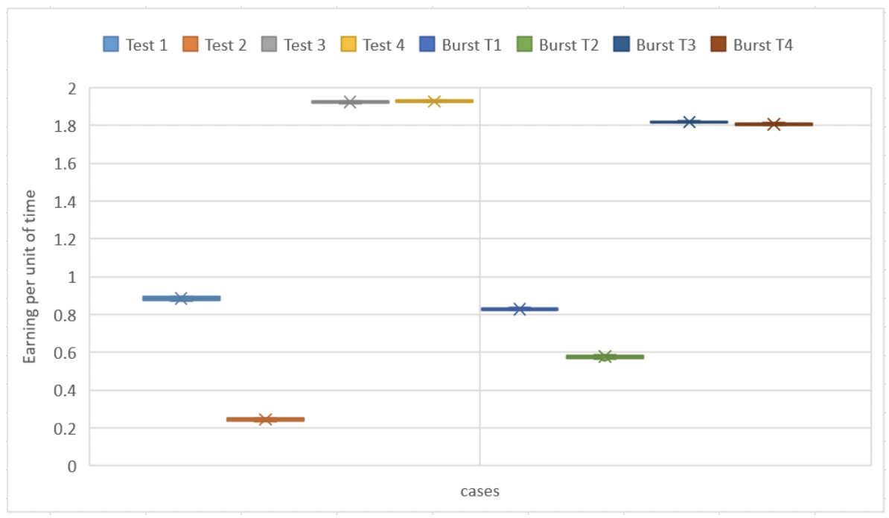
Comparison and Conclusion
Low owner sit threshold
“individual > burst”
from the earnings
point of view
High sit number and patience threshold
“burst > individual” in earning.
Burst arrival = exponential arrival with some arrivals with interarrival time of 0sec. => small waiting time for a child in the queue
Low children patience and higher sit threshold
The above plot shows the range of values for the four test cases become narrower in burst arrival cases in comparison to individual arrival
For lower patience of children
Recommended to decrease the minimum sit number threshold for either cases

Slide 12
End of the Slide
Thank You!

